Slide 1
17 Example of software change
Application framework Drawlets
  adds graphical display to a host application
Drawing canvas
  lines, free-hand lines, rectangles, rounded rectangles, triangles, pentagons, polygons, ellipses, text boxes, images
© 2012 by Václav Rajlich

Slide 2
Drawlets - features
More than 100 classes, 35 interfaces and 40,000 lines of code
  originally implemented by Kent Beck, Ward Cunningham
  later ported into Java
  “perfect API”
  http://www.rolemodelsoft.com/aboutUs/ drawlets.htm
© 2012 by Václav Rajlich

Slide 3
The host application
Responsible for providing an instance of the drawing canvas, toolbars, and tool buttons
Class SimpleApplet is a host application
  is a part of the Drawlet library
  SimpleApplet runs in any browser
© 2012 by Václav Rajlich

Slide 4
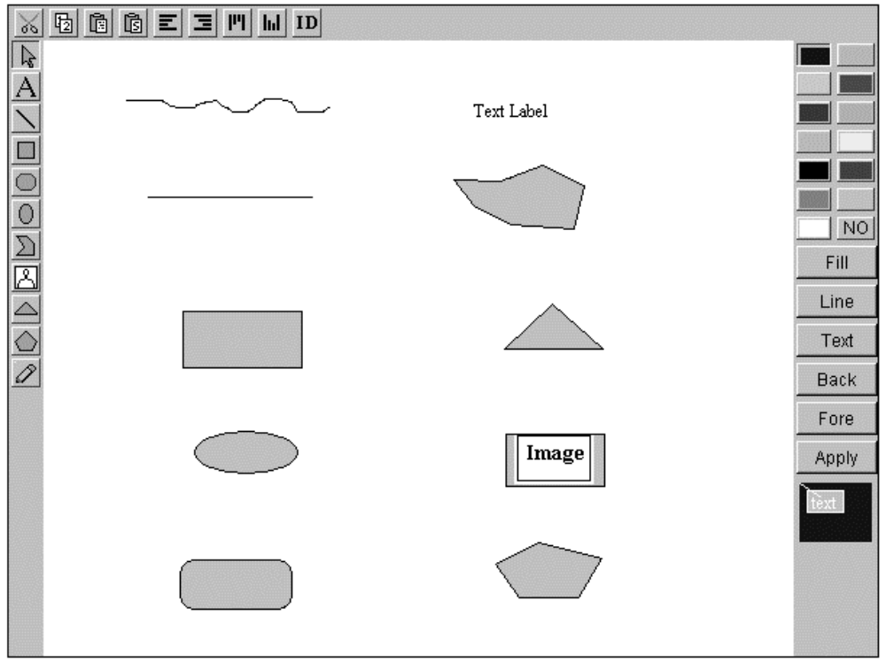
SimpleApplet window
© 2012 by Václav Rajlich

Slide 5
Top classes
LocatorConnectionHandle
AbstractFigure
Locator
Figure
StylePalette
SequenceOfFigures
SimpleApplet
DrawingCanvas
ToolBar
CanvasTool
SimpleDrawingCanvas
ToolPalette
SelectionTool
ConstructionTool
PrototypeConstructionTool
ShapeTool
LabelTool
RectangleTool
EllipseTool
RectangularCreationTool
PG_RectImageTool
© 2012 by Václav Rajlich

Slide 6
Change Request
Implement an owner for each figure.
  An owner is the user who put the figure onto the canvas, and only the owner should be allowed to modify it.
  At the beginning of a session, the users input their ID and password and they are the owners of all figures that were created during the session.
This change will make SimpleApplet more versatile and useful
  support for cooperative work
© 2012 by Václav Rajlich

Slide 7
Concepts
Implement an owner for each figure.
  An owner is the user who put the figure onto the canvas, and only the owner should be allowed to modify it.
  At the beginning of a session, the users input their ID and password and they are the owners of all figures that were created during the session
© 2012 by Václav Rajlich

Slide 8

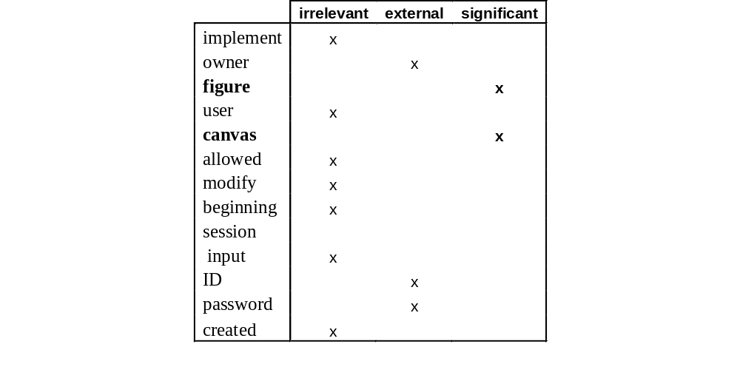
Concept classification
© 2012 by Václav Rajlich

Slide 9
Locating figure properties
LocatorConnectionHandle
AbstractFigure
Locator
Figure
StylePalette
SequenceOfFigures
SimpleApplet
DrawingCanvas
ToolBar
CanvasTool
SimpleDrawingCanvas
ToolPalette
SelectionTool
ConstructionTool
PrototypeConstructionTool
ShapeTool
LabelTool
RectangleTool
EllipseTool
RectangularCreationTool
PG_RectImageTool
© 2012 by Václav Rajlich

Slide 10
Wrong way
LocatorConnectionHandle
AbstractFigure
Locator
Figure
StylePalette
SequenceOfFigures
SimpleApplet
DrawingCanvas
ToolBar
CanvasTool
SimpleDrawingCanvas
ToolPalette
SelectionTool
ConstructionTool
PrototypeConstructionTool
ShapeTool
LabelTool
RectangleTool
EllipseTool
RectangularCreationTool
PG_RectImageTool
© 2012 by Václav Rajlich

Slide 11
Backtrack
LocatorConnectionHandle
AbstractFigure
Locator
Figure
StylePalette
SequenceOfFigures
SimpleApplet
DrawingCanvas
ToolBar
CanvasTool
SimpleDrawingCanvas
ToolPalette
SelectionTool
ConstructionTool
PrototypeConstructionTool
ShapeTool
LabelTool
RectangleTool
EllipseTool
RectangularCreationTool
PG_RectImageTool
© 2012 by Václav Rajlich

Slide 12
Right way
LocatorConnectionHandle
AbstractFigure
Locator
Figure
StylePalette
SequenceOfFigures
SimpleApplet
DrawingCanvas
ToolBar
CanvasTool
SimpleDrawingCanvas
ToolPalette
SelectionTool
ConstructionTool
PrototypeConstructionTool
ShapeTool
LabelTool
RectangleTool
EllipseTool
RectangularCreationTool
PG_RectImageTool
© 2012 by Václav Rajlich

Slide 13
Wrong way
LocatorConnectionHandle
AbstractFigure
Locator
Figure
StylePalette
SequenceOfFigures
SimpleApplet
DrawingCanvas
ToolBar
CanvasTool
SimpleDrawingCanvas
ToolPalette
SelectionTool
ConstructionTool
PrototypeConstructionTool
ShapeTool
LabelTool
RectangleTool
EllipseTool
RectangularCreationTool
PG_RectImageTool
© 2012 by Václav Rajlich

Slide 14
Backtrack
LocatorConnectionHandle
AbstractFigure
Locator
Figure
StylePalette
SequenceOfFigures
SimpleApplet
DrawingCanvas
ToolBar
CanvasTool
SimpleDrawingCanvas
ToolPalette
SelectionTool
ConstructionTool
PrototypeConstructionTool
ShapeTool
LabelTool
RectangleTool
EllipseTool
RectangularCreationTool
PG_RectImageTool
© 2012 by Václav Rajlich

Slide 15
Summary
LocatorConnectionHandle
AbstractFigure
Locator
Figure
StylePalette
SequenceOfFigures
SimpleApplet
DrawingCanvas
ToolBar
CanvasTool
SimpleDrawingCanvas
ToolPalette
SelectionTool
ConstructionTool
PrototypeConstructionTool
ShapeTool
LabelTool
RectangleTool
EllipseTool
RectangularCreationTool
PG_RectImageTool
© 2012 by Václav Rajlich

Slide 16
Actualization
LocatorConnectionHandle
AbstractFigure
Locator
Figure
StylePalette
SequenceOfFigures
OwnerIdentity
SimpleApplet
DrawingCanvas
ToolBar
CanvasTool
SimpleDrawingCanvas
SimpleListener
ToolPalette
SelectionTool
ConstructionTool
PrototypeConstructionTool
ShapeTool
LabelTool
RectangleTool
EllipseTool
RectangularCreationTool
PG_RectImageTool
© 2012 by Václav Rajlich

Slide 17
Change propagation
LocatorConnectionHandle
AbstractFigure
Locator
Figure
StylePalette
SequenceOfFigures
OwnerIdentity
SimpleApplet
DrawingCanvas
ToolBar
CanvasTool
SimpleDrawingCanvas
SimpleListener
ToolPalette
SelectionTool
ConstructionTool
PrototypeConstructionTool
ShapeTool
LabelTool
RectangleTool
EllipseTool
RectangularCreationTool
PG_RectImageTool
© 2012 by Václav Rajlich

Slide 18
Propagation - 1
LocatorConnectionHandle
AbstractFigure
Locator
Figure
StylePalette
SequenceOfFigures
OwnerIdentity
SimpleApplet
DrawingCanvas
ToolBar
CanvasTool
SimpleDrawingCanvas
SimpleListener
ToolPalette
SelectionTool
ConstructionTool
PrototypeConstructionTool
ShapeTool
LabelTool
RectangleTool
EllipseTool
RectangularCreationTool
PG_RectImageTool
© 2012 by Václav Rajlich

Slide 19
Propagation - 2
LocatorConnectionHandle
AbstractFigure
Locator
Figure
StylePalette
SequenceOfFigures
OwnerIdentity
SimpleApplet
DrawingCanvas
ToolBar
CanvasTool
SimpleDrawingCanvas
SimpleListener
ToolPalette
SelectionTool
ConstructionTool
PrototypeConstructionTool
ShapeTool
LabelTool
RectangleTool
EllipseTool
RectangularCreationTool
PG_RectImageTool
© 2012 by Václav Rajlich

Slide 20
Propagation - 3
LocatorConnectionHandle
AbstractFigure
Locator
Figure
StylePalette
SequenceOfFigures
OwnerIdentity
SimpleApplet
DrawingCanvas
ToolBar
CanvasTool
SimpleDrawingCanvas
SimpleListener
ToolPalette
SelectionTool
ConstructionTool
PrototypeConstructionTool
ShapeTool
LabelTool
RectangleTool
EllipseTool
RectangularCreationTool
PG_RectImageTool
© 2012 by Václav Rajlich

Slide 21
Propagation - 4
LocatorConnectionHandle
AbstractFigure
Locator
Figure
StylePalette
SequenceOfFigures
OwnerIdentity
SimpleApplet
DrawingCanvas
ToolBar
CanvasTool
SimpleDrawingCanvas
SimpleListener
ToolPalette
SelectionTool
ConstructionTool
PrototypeConstructionTool
ShapeTool
LabelTool
RectangleTool
EllipseTool
RectangularCreationTool
PG_RectImageTool
© 2012 by Václav Rajlich

Slide 22
Propagation - 5
LocatorConnectionHandle
AbstractFigure
Locator
Figure
StylePalette
SequenceOfFigures
OwnerIdentity
SimpleApplet
DrawingCanvas
ToolBar
CanvasTool
SimpleDrawingCanvas
SimpleListener
ToolPalette
SelectionTool
ConstructionTool
PrototypeConstructionTool
ShapeTool
LabelTool
RectangleTool
EllipseTool
RectangularCreationTool
PG_RectImageTool
© 2012 by Václav Rajlich

Slide 23
Propagation - 6
LocatorConnectionHandle
AbstractFigure
Locator
Figure
StylePalette
SequenceOfFigures
OwnerIdentity
SimpleApplet
DrawingCanvas
ToolBar
CanvasTool
SimpleDrawingCanvas
SimpleListener
ToolPalette
SelectionTool
ConstructionTool
PrototypeConstructionTool
ShapeTool
LabelTool
RectangleTool
EllipseTool
RectangularCreationTool
PG_RectImageTool
© 2012 by Václav Rajlich

Slide 24
Propagation - done
LocatorConnectionHandle
AbstractFigure
Locator
Figure
StylePalette
SequenceOfFigures
OwnerIdentity
SimpleApplet
DrawingCanvas
ToolBar
CanvasTool
SimpleDrawingCanvas
SimpleListener
ToolPalette
SelectionTool
ConstructionTool
PrototypeConstructionTool
ShapeTool
LabelTool
RectangleTool
EllipseTool
RectangularCreationTool
PG_RectImageTool
© 2012 by Václav Rajlich

Slide 25
Unit Tests
385 unit tests
1369 assertions
4800 lines.
© 2012 by Václav Rajlich

Slide 26
Functional tests
Draw
  figure drawn on the canvas, for all figures
Select
  figure is selected
Move
  figure is moved to a different location
. . .
  141 functional test cases
© 2012 by Václav Rajlich

Slide 27
Creation of functional tests
Record/playback tool for Java applications
Tool Abbot used to run the functional tests
© 2012 by Václav Rajlich

Slide 28
Phase of actualization
New unit tests for new classes
New functional tests for the new functionality
During the change propagation, the old tests that were impacted by the change were updated.
© 2012 by Václav Rajlich

Slide 29
Test suite maintenance
Tests from the old version that are not affected by the change are kept as regression tests for the future
Obsolete tests are removed
Tests of the new features are added after the change
© 2012 by Václav Rajlich

Slide 30
Results
Base line
  production code 17800 lines
  unit test code 4800 lines.
Change
  91 lines of production code (0.5%) were modified
  124 lines (2.5%) of the test code
  approximately 1.4 test code lines per modified production code line.
© 2012 by Václav Rajlich

Slide 31
Refactoring
Long change propagation is a problem
  it would be advantageous to shorten it
Refactoring can shorten the change propagation
  move code affected by change into fewer classes
  split the roles
© 2012 by Václav Rajlich

Slide 32
Propagation
LocatorConnectionHandle
AbstractFigure
Locator
Figure
StylePalette
SequenceOfFigures
OwnerIdentity
SimpleApplet
DrawingCanvas
ToolBar
CanvasTool
SimpleDrawingCanvas
SimpleListener
ToolPalette
SelectionTool
ConstructionTool
PrototypeConstructionTool
ShapeTool
LabelTool
RectangleTool
EllipseTool
RectangularCreationTool
PG_RectImageTool
© 2012 by Václav Rajlich

Slide 33
Moving the code
Each class that creates new figures has the function basicNewFigure(...)
  two main parts:
    create a new figure
    if the figure was created at wrong location, move it
We refactored a new method called moveFigure(...)
  made it a member of the base class ConstructionTool
© 2012 by Václav Rajlich

Slide 34
Refactoring impact
LocatorConnectionHandle
AbstractFigure
Locator
Figure
StylePalette
SequenceOfFigures
SimpleApplet
DrawingCanvas
ToolBar
CanvasTool
SimpleDrawingCanvas
ToolPalette
SelectionTool
ConstructionTool
PrototypeConstructionTool
ShapeTool
LabelTool
RectangleTool
EllipseTool
RectangularCreationTool
PG_RectImageTool
© 2012 by Václav Rajlich

Slide 35
Splitting of roles
Same method used in two different roles
  the same code can do both jobs
Propagating change highlights the differences
  only one of the roles needs to be updated
  the other one can stay unchanged
  splitting the two roles and updating only one of them shortens the propagation
© 2012 by Václav Rajlich

Slide 36
Splitting the roles
Function move(...) in AbstractFigure is used in two ways
  to move the figure as requested by the user
    must check user identity
  as a part of the new figure creation
    does not need to check user identity
We split move(...)and secureMove(…)
© 2012 by Václav Rajlich

Slide 37
Numerical data
 | No refactoring | Move function | Splitting
Classes added | 2 | 2 | 2
Interfaces modified | 1 | 1 | 1
Classes modified | 13 | 8 | 5
LOC modified | 91 | 95 | 87
© 2012 by Václav Rajlich

Slide 38
Conclusions
Splitting up a method into two similar methods may require least work
Minus: A new set of unit tests must be created, thus test code is duplicated.
Minus: More effort is required to create new tests compared to the effort required to adapt existing tests to their changed implementation.
Possible problem: Does Role splitting strategy lead to system degeneration?
© 2012 by Václav Rajlich

